Slide 1
Selenium Installation Guide

Slide 2
Requirments
JDK - https://www.oracle.com/java/technologies/javase-downloads.html
-cmd: java –version (check if java installed on your pc)
Eclipse- https://www.eclipse.org/downloads/

Slide 3
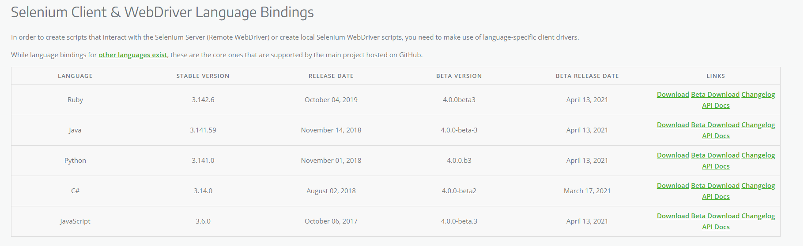
Install selenium
https://www.selenium.dev/downloads/
Download the java client

Slide 4
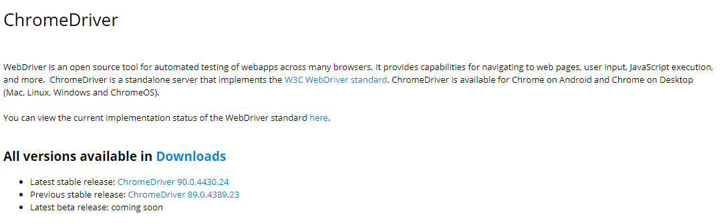
Browsers
We will download the chrome driver (there are other options such as firefox GeckoDriver, Microsoft Edge WebDriver etc..)
https://sites.google.com/a/chromium.org/chromedriver/
Selenium will use the web driver to interact with the browser

Slide 5
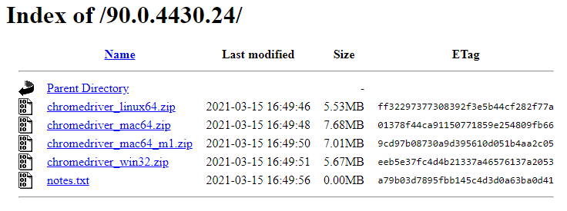
Browsers
Choose the zip file to download based on the operating system.
For windows: chromedriver_win32.zip
Note that the installed chrome version on your computer must match the chromedriver version.
https://help.zenplanner.com/hc/en-us/articles/204253654-How-to-Find-Your-Internet-Browser-Version-Number-Google-Chrome

Slide 6
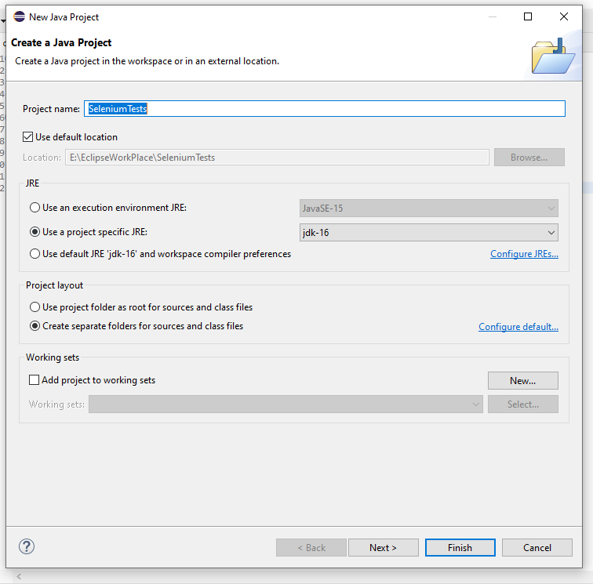
Create new project- eclipse
Create new java project
Name the project as you wish and click next

Slide 7
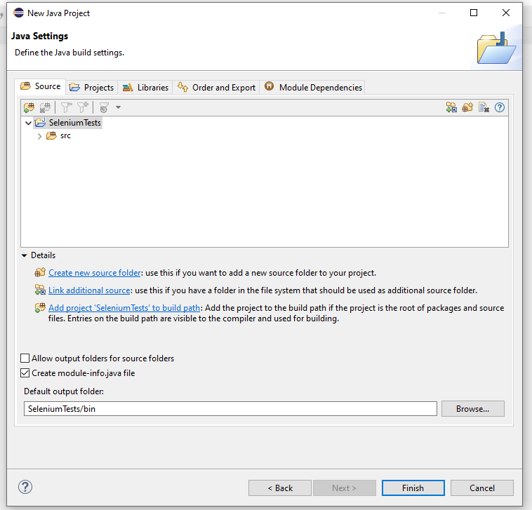
Create new project- eclipse
Click on Libraries

Slide 8
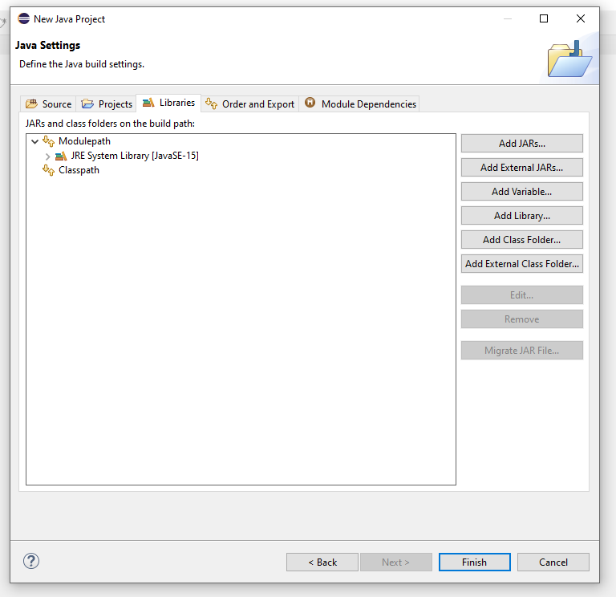
Create new project- eclipse
Choose Add External JARs…

Slide 9
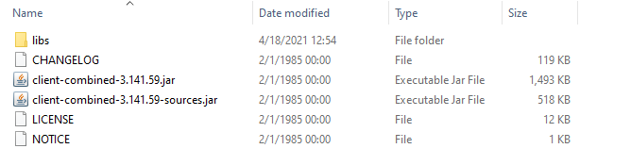
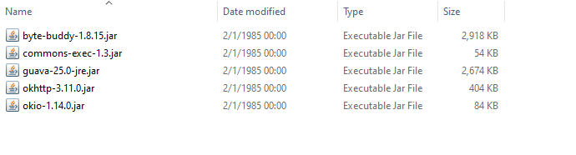
Create new project- eclipse
Choose all the files that were extracted from the zip of the java client (slide 3) and click open. Note that you will need to add the client jar files and the jar files in the libs directory.

Slide 10
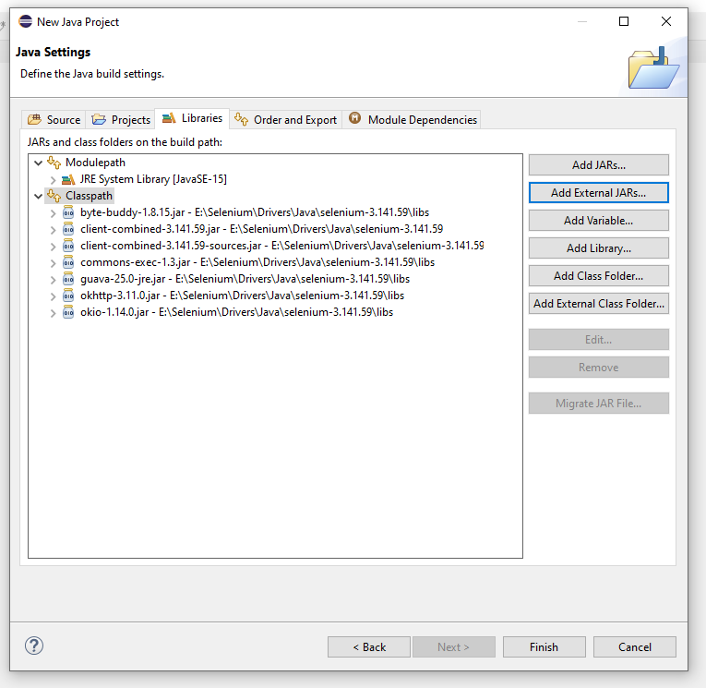
Create new project- eclipse
The files will then appear in the Classpath.
Click Finish.

Slide 11
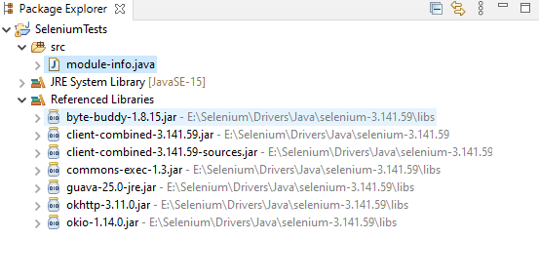
New project is ready- eclipse
You will be able to see the files in the Referenced Libraries in the Package Explorer

Slide 12
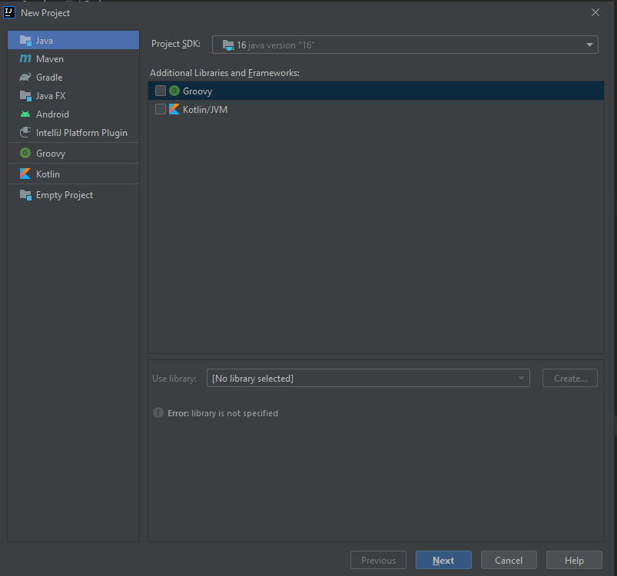
Create new project- IntelliJ
Create new simple java project and click next

Slide 13
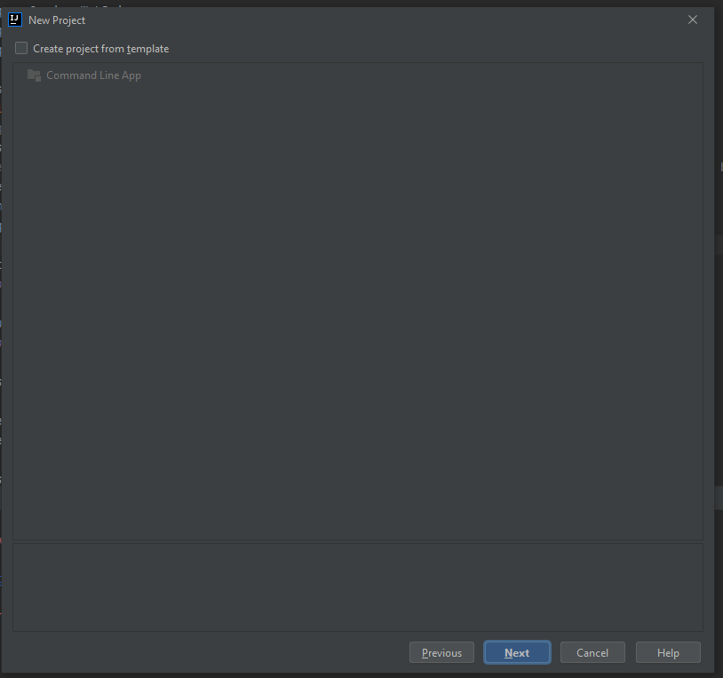
Create new project- IntelliJ
Not necessary to create project from table. You can click next.

Slide 14
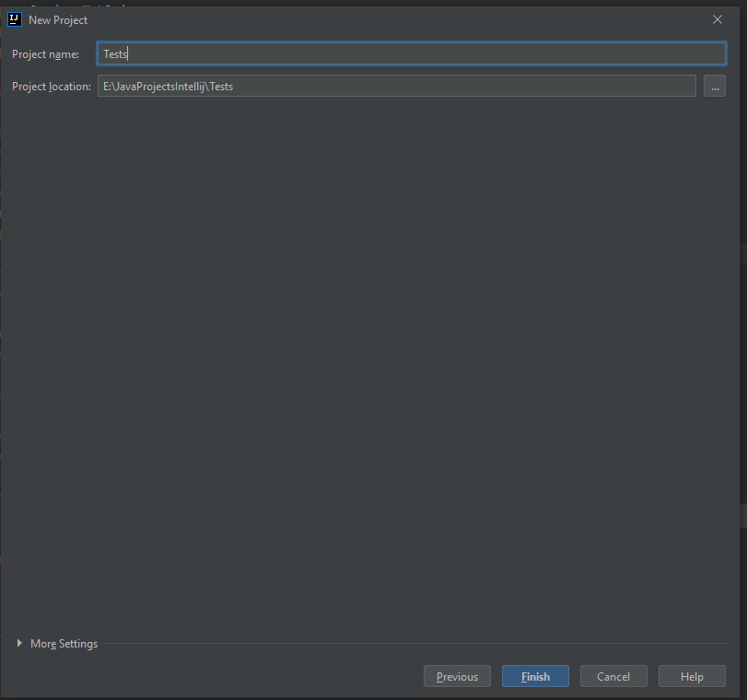
Create new project- IntelliJ
Name the project and click finish.
The project now is ready, all is left to do is to add Selenium to the project

Slide 15
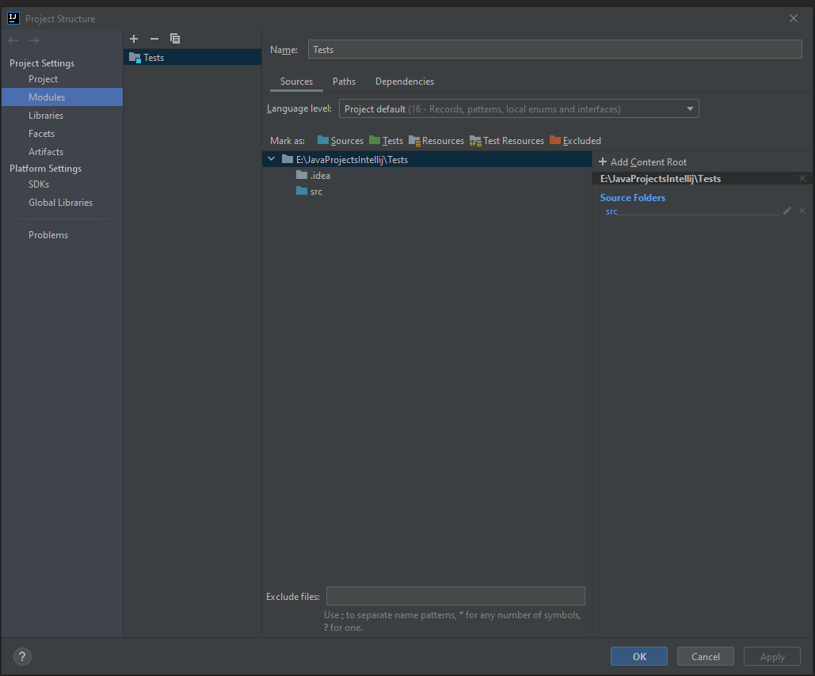
Add Selenium to Java project- IntelliJ
Press right click on the project
Choose Open Module Settings
OR
Click F4 to open Module Settings
You will see the following window =>
Click on Dependencies

Slide 16
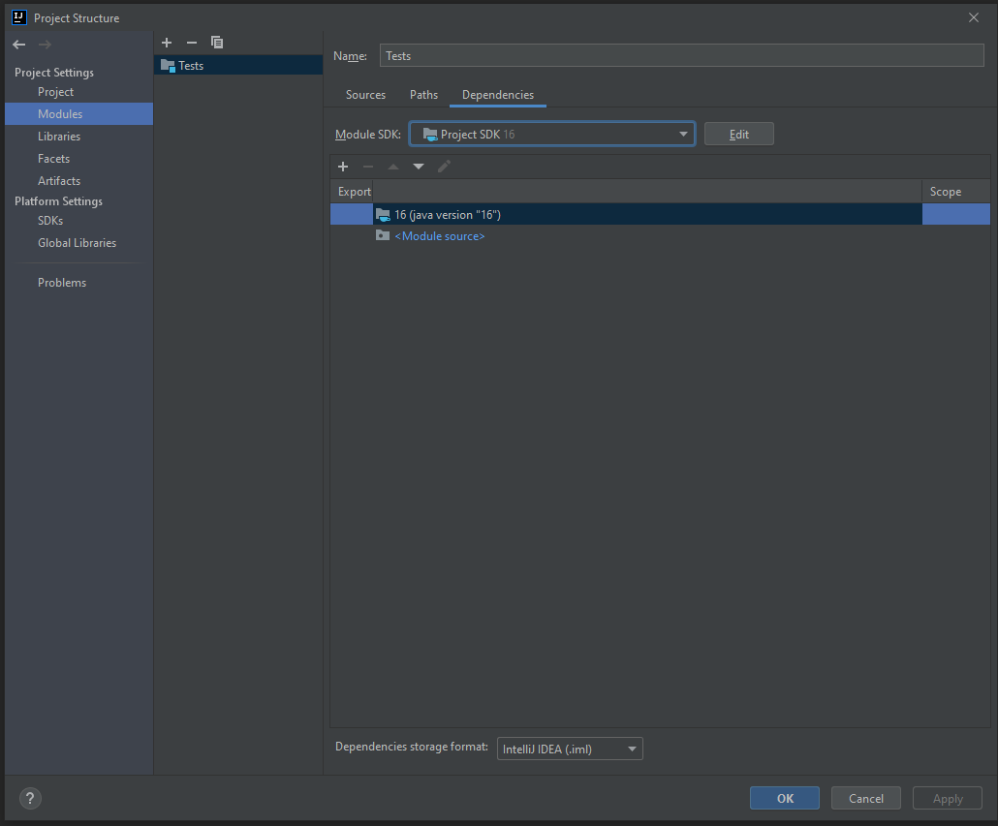
Add Selenium to Java project- IntelliJ
Click on the + buttom under the Module SDK
Choose JARs or Directories

Slide 17
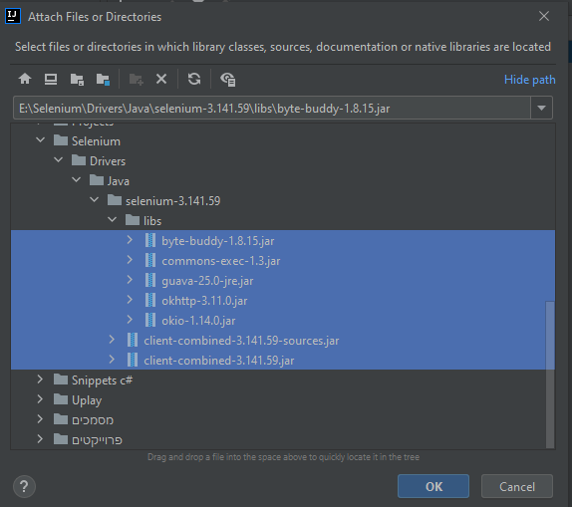
Add Selenium to Java project- IntelliJ
Choose all the files that were extracted from the zip of the java client (slide 3) and click ok. Note that you will need to add the client jar files and the jar files in the libs directory.
You will return back to the Dependencies window. Click apply and ok.

Slide 18
Hello World Example
You can use selenium with different tests frameworks and without them.
First, we will see simple Hello World example without any test framework
https://github.com/Mark6197/SeleniumDemos/blob/main/Demo1/SeleniumHelloWorld.java

Slide 19
Selenium ide extension for browser
Powerful tool that allows us to the test the website without even writing code.
The extension is currently available on Google Chrome and Firefox only.
Download the extension for chrome from here: https://chrome.google.com/webstore/detail/selenium-ide/mooikfkahbdckldjjndioackbalphokd/related
The ide allows us to record user interactions on the website. It builds a command from each interaction and enables us to play back the commands together as a test. The recorded tests can be later edited.

Slide 20
Simple example
In the following slide you will see simple recorded test in which we open google and type Hello in the search bar, then we will test that the text is indeed the same text we have inserted.

Slide 21
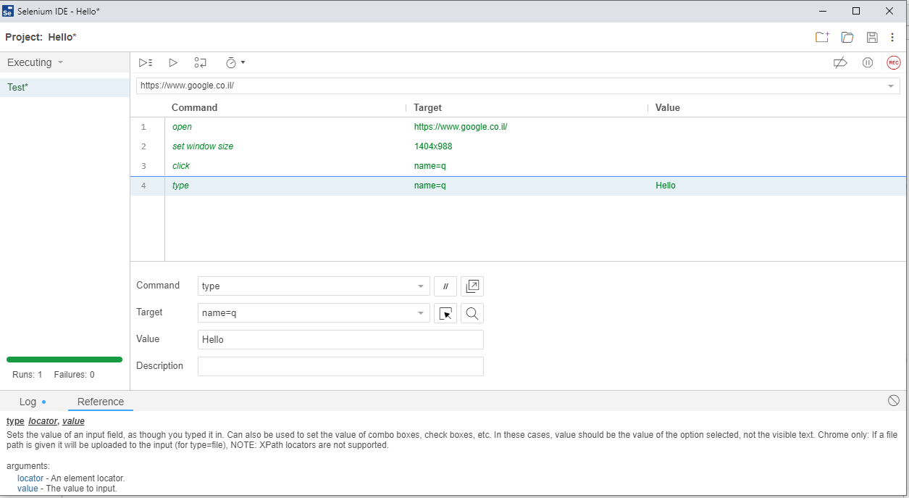
Selenium ide extension for browser- Quick Overview
Simple test case the opens google and searching for Hello
Run all tests
Run current test
Step over command
Record
The url of the page we want to test
List of commands generated by the ide
Control test execution speed
Details of selected command such as the target and the value we are sending.

Slide 22
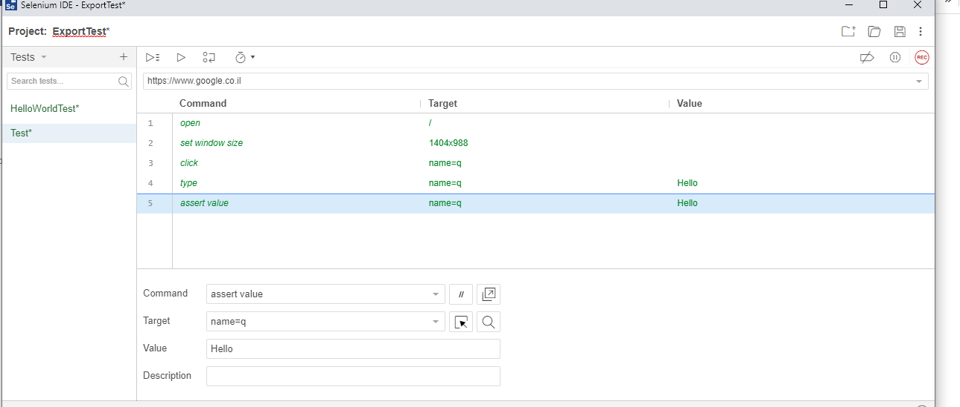
Add Assert
You can add assert different assert statements in the ide such as assert text, assert value, assert checked etc..
In our case we will add assert value statement

Slide 23
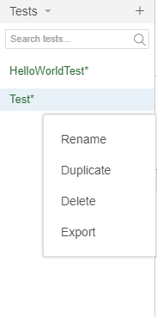
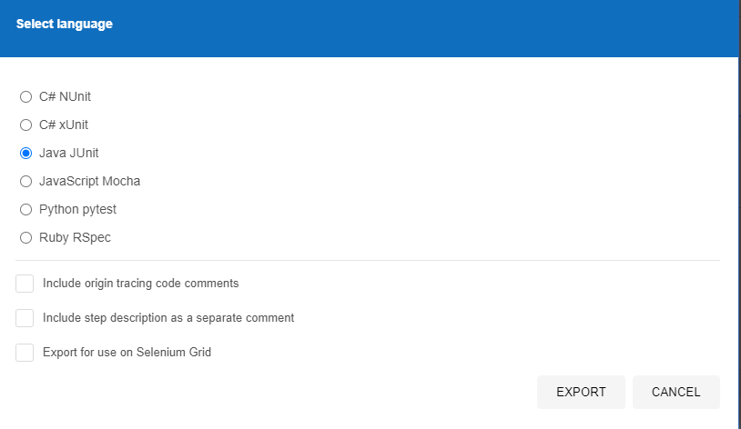
Export the tests
When hovering over the test’s name on the left side of the IDE you will be able to expand the following menu by clicking on the 3 dots. ➔
Click on Export, you will see the window below
Select Java Junit
Save the file in the desired location.
Project using maven and generated script:
https://github.com/Mark6197/SeleniumDemos/tree/main/Demo3

